Slide 1
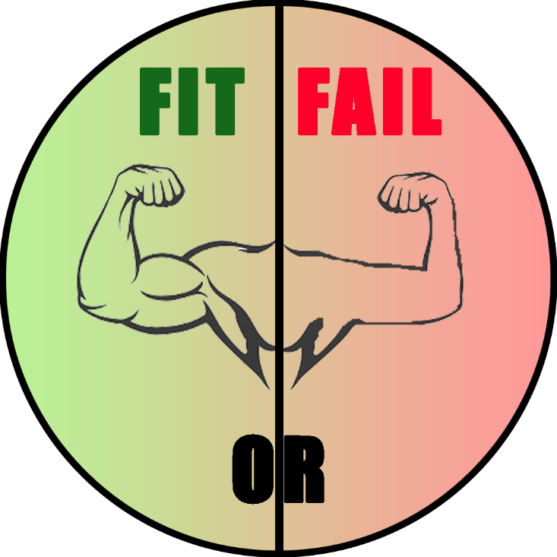
Fit or Fail a revolutionary fitness game
Travis Stewart
Christian Sauls
Josh Shevitz

Slide 2
Purpose of The Game
Purpose
To create a fun, interactive learning experience that educates teens on consistent healthy lifestyle decisions such as diet and exercise
US Dept of Health and Human Services (DHHS) – “teens today are more likely to develop a sustained interest in a healthy, active lifestyle if they are provided with some type of technology-based “game-like” tool to stimulate their interest in the areas.“
Focus group: high school aged teens, eventually expanding to children of all ages
Primary platform: mobile

Slide 3

About Our Game
Online multiplayer trivia game
Questions to be chosen randomly from a pool of fitness-related questions
Game modes:
Simple trivia:
Solo – Play by yourself, answering a handful of randomly-chosen questions
Kahoot!-style trivia:
Online – Play for points competitively against other individuals
Users can create and join “Teams”
User accounts store data for cumulative points earned and total match victories
Users in a Team contribute their earnings to their Team’s statistics as well

Slide 4
Technologies Used
Front end:
HTML/CSS
JavaScript
React
Bootstrap (possibly)
Back end
MongoDB
JavaScript
Express.js
JSON Web Tokens
Domain/Hosting provider
Heroku (https://www.heroku.com/)
Collaboration:
GitHub/Git
GroupMe
Google Hangouts
Miscellaneous
Various npm packages
Postman to make HTML requests for backend testing

Slide 5
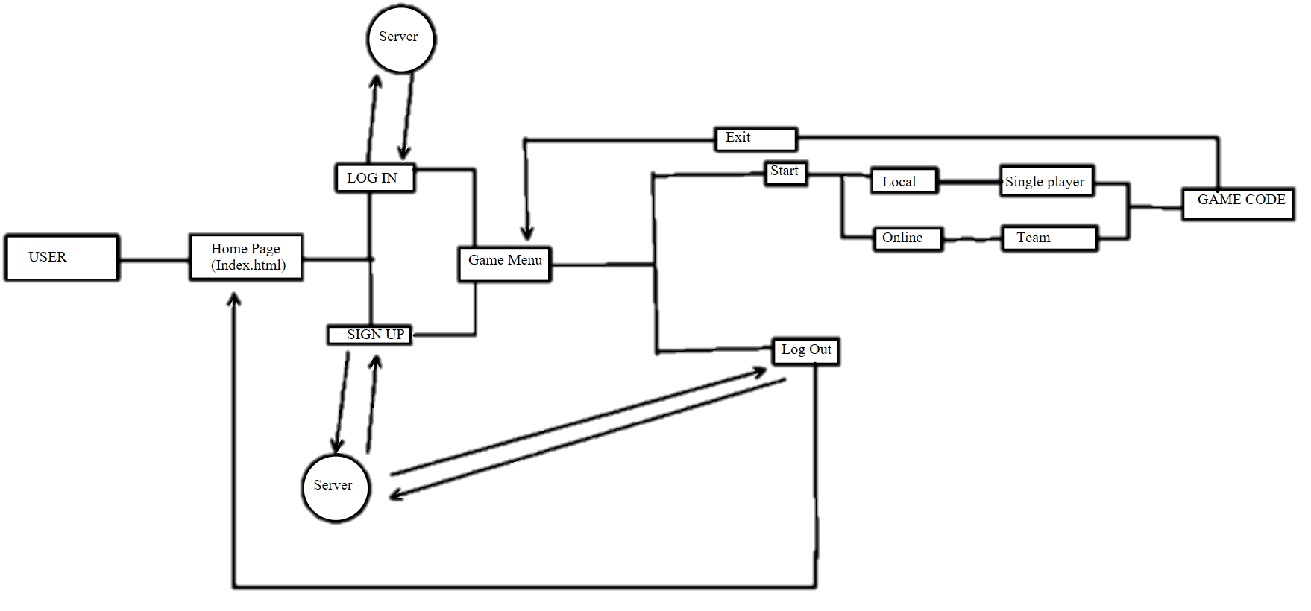
Website game layout

Slide 6
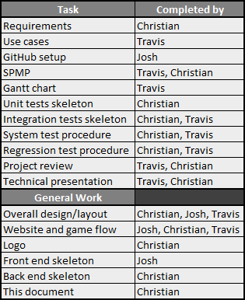
Roles and Contributions
Christian Sauls – Programmer (backend), coordinator, minor documenter, minor designer, minor frontend
Travis Stewart – Documenter (SPMP, use cases, Gantt chart, and more), minor designer
Josh Shevitz – Programmer (frontend), coordinator, designer
Adamma Neuman – programmer
Kafui D - programmer

Slide 7
Roles and Contributions Cont.
General Work | Completed by
Overall design/layout | Christian, Josh, Travis
Website and game flow | Josh, Christian, Travis
Logo | Christian
Front end skeleton | Josh
Game Menu
Single Player Game
Multiplayer Game
Leaderboard page
Donate Page
Back end skeleton | Christian
This document | Christian

Slide 8
Next Steps
We will continue to develop a multiplayer mode
This is our next primary objective
Will take place over the next month
We will continue to maintain the site and do more extensive testing
The first release will be a beta stage, and we will eventually get to the final tested version
To Secure some ads for on the site.
We will add new and updated questions for the game
We may separate games by fitness question categories.
Ex: Healthy Eating, Muscle Development, etc.

Slide 9
Why We Deserve to win
Detailed planning went into our design and implementation
We are using Hot languages to implement our product (React, MongoDB, Express)
Our product has the ability to be played on mobile devices or converted to a physical mobile application
We dedicated a lot of time not only learning HTML and CSS but also more unique languages such as React, MongoDB, Express JS.
Deployment of site is simple and fast
Extra feature we added
Donate page

Slide 10
Demo of Product
To access our site, visit the following url:
https://fit-or-fail.herokuapp.com/

